Slide 1

PROJECT
MatchX
Order Book Simulator
NIRMA UNIVERSITY | INSTITUTE OF TECHNOLOGY
Data Structure
Stock-exchange matching engine with price–time priority, live order books for 60 stocks and a demo trading account
Innovative Assignment 2
Course Code: 6CS102CC26
BUILT WITH
Student
Kelly Gandhi
|
26MCA019
JavaScript and React in one HTML page, with binary heaps, a hash map and a circular buffer
Sujal Patel
|
26MCA043
Faculty
Prof. Nirav Patel
Notes:
MatchX simulates a stock exchange: every order goes into an order book and the matching engine pairs buyers and sellers by best price first, then earliest arrival.

Slide 2
An exchange must always know the best prices
The problem
Order book for one stock
Sell ₹102.00
qty 8
Thousands of buy and sell orders arrive every second
The best price must be found instantly
Equal prices must be served fairly, first come first served
Sell ₹101.50
qty 12
Sell ₹101.00
qty 5
Spread ₹0.50
Buy ₹100.50
qty 10
Buy ₹100.00
qty 7
Buy ₹99.50
qty 14
MatchX answer: keep each side of every book in a binary heap, ordered by price and then by arrival number.

Slide 3




Project objectives
Heap-based order books
Price–time priority
Best price in O(1), insert and remove in O(log n)
Better price first; at equal price, earlier order first
Cheap cancel and modify
Safe trading account
Hash map lookup plus lazy deletion, O(1) cancel
Cash and shares locked by open orders can't be reused

Slide 4
Every order follows the same five steps
1
2
3
4
5
Submit
Validate
Match
Leftover?
Record
New ID and arrival number
Price, whole quantity, free cash or shares
Trade against the opposite heap's top
Limit: rest in heap
Market: cancel
Trade, audit event, alert
A rejected order stops at step 2 and is logged as REJECTED with the reason shown to the user.

Slide 5
Two heaps per stock keep the best price on top
Sell side: min-heap by price, then arrival
// buys: higher price first, then earlier
const bidC = (x, y) =>
y.price - x.price || x.seq - y.seq;
// sells: lower price first, then earlier
const askC = (x, y) =>
x.price - y.price || x.seq - y.seq;
peek() → best price O(1)
push(o) → sift up O(log n)
pop() → sift down O(log n)
₹100
order #3
₹100
order #7
₹101
order #2
₹102
order #1
₹101.5
order #9
₹103
order #4
Top = best ask. Two orders at ₹100: #3 arrived first, so it is on top.
Same Heap class for both sides; only the comparator changes.

Slide 6
Seven data structures, each with one job
Structure | How MatchX uses it | Cost
Binary heap | Max-heap of buys, min-heap of sells per stock | O(log n) insert, O(1) best
Sequence number | Tie-breaker so equal prices are first in, first out | O(1) per compare
Hash map + set | Order ID → order; set of your open orders | O(1) average
Lazy deletion | Cancel only marks; dropped when it reaches the top | Cancel O(1)
Circular buffer | Audit trail of the latest 2,000 events | Add O(1)
Dynamic array | Trades and price history for charts | Append O(1) amortised
Sorted array | Baseline engine used only in the benchmark | Insert O(n)

Slide 7
Matching trades at the resting order's price
1
Skip cancelled orders at the opposite heap's top
while (o.rem > 0) {
let top = opp.peek();
while (top && !live(top)) {
opp.pop(); top = opp.peek(); }
if (!top || !crosses(o, top)) break;
const q = Math.min(o.rem, top.rem);
const p = top.price;
o.rem -= q; top.rem -= q;
recordTrade(p, q);
if (!top.rem) { opp.pop(); done(top); }
}
2
Stop if the prices don't cross
3
Trade min(remaining, top's remaining) at the top's price
4
Pop the top when it's fully filled; repeat
A buy at ₹110 against a resting sell at ₹100 trades at ₹100, so the buyer gets the better price.

Slide 8



Market orders, cancels and modifications
Market order
Cancel
Modify
Sent at best price ± 5% with immediate-or-cancel. Whatever can't fill within 5% is cancelled, so a thin book can't give a terrible price.
Look up the ID in the hash map and mark it cancelled: O(1). The heap entry is skipped later, when it reaches the top (lazy deletion).
Smaller quantity at the same price: changed in place, keeps its place in the queue. New price or more quantity: re-queued with a new ID and loses priority.

Slide 9
Every core operation is constant or logarithmic
O(1)
O(log n)
O(1)
O(k log n)
Best bid / ask
Add a resting order
Cancel
Match an order
Top of the heap
Heap sift-up
Hash map + lazy delete
k fills, one pop each
n = orders on one side of one stock's book · k = trades created by one order · Audit trail uses fixed memory (2,000 slots)

Slide 10
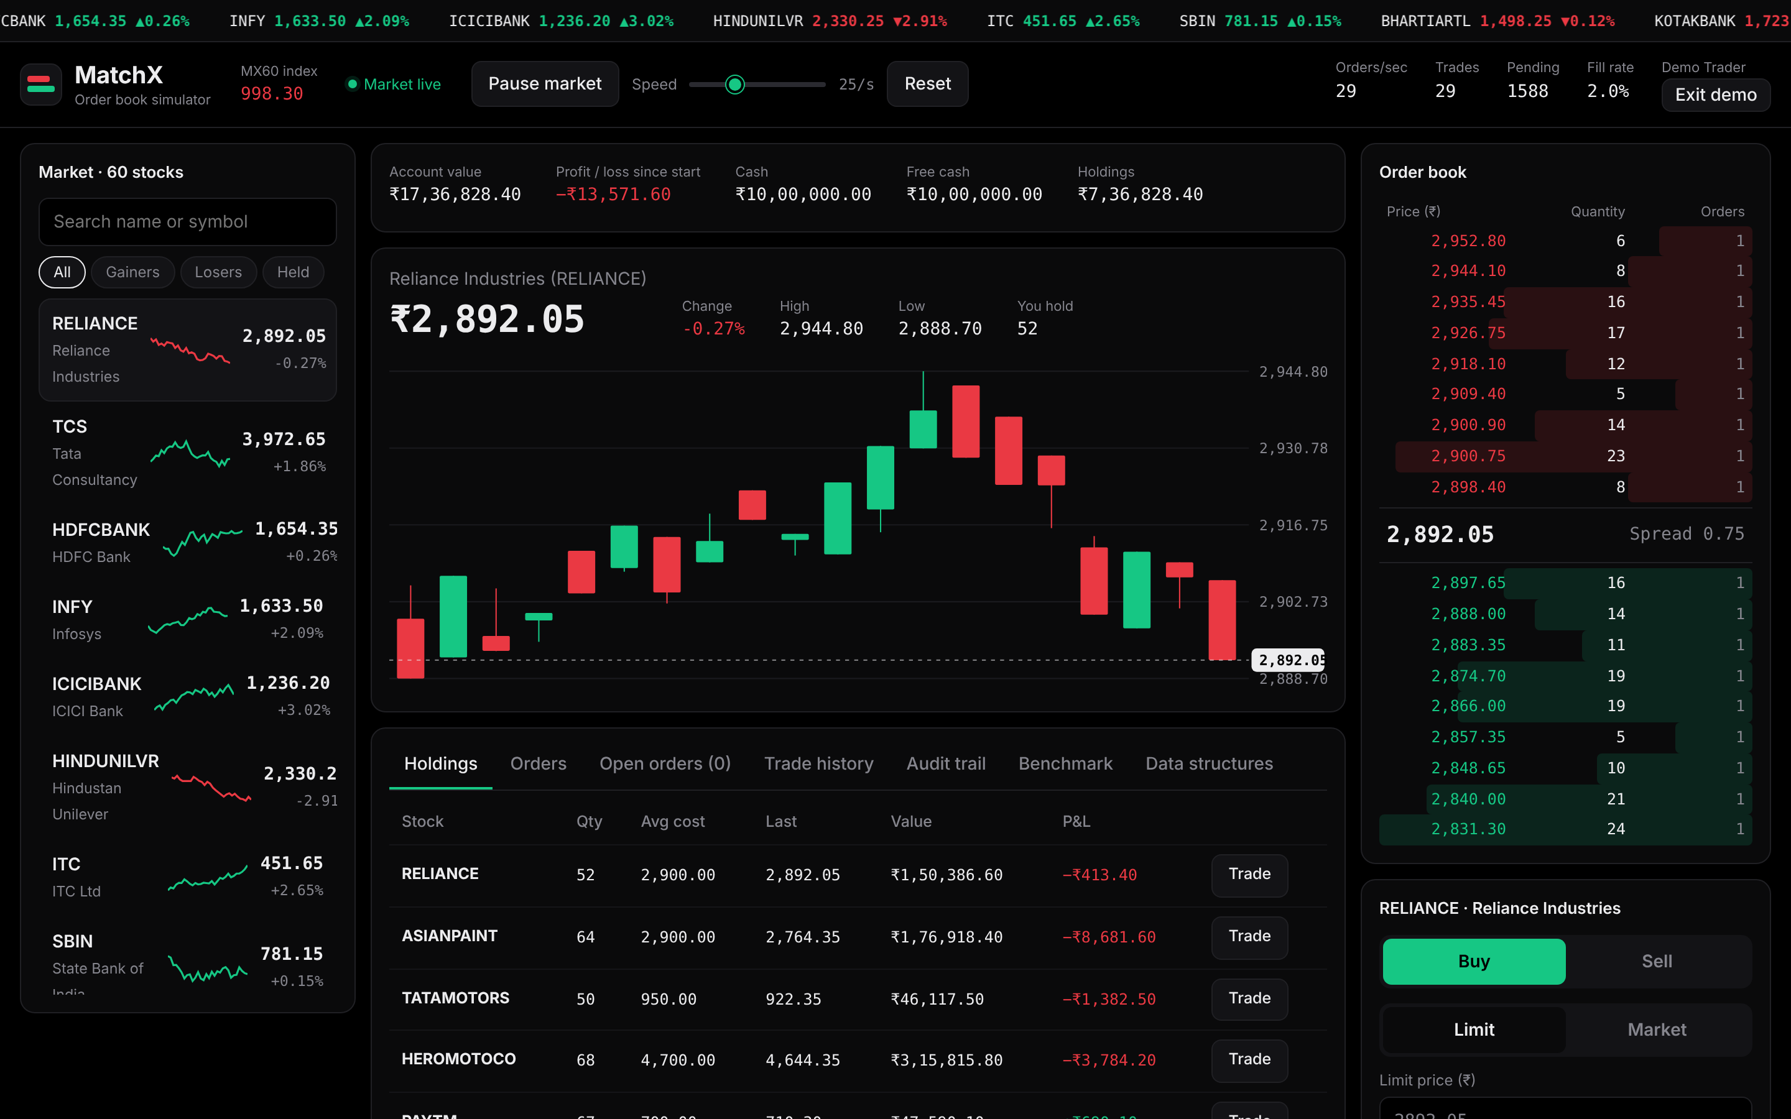
A live trading dashboard for 60 stocks
Watchlist with search, filters and sparklines
Candlestick chart of recent trades
Order book with depth bars and spread
Order ticket for limit or market, with a confirmation step
Tabs for holdings, orders, trades, audit trail and benchmark

Slide 11
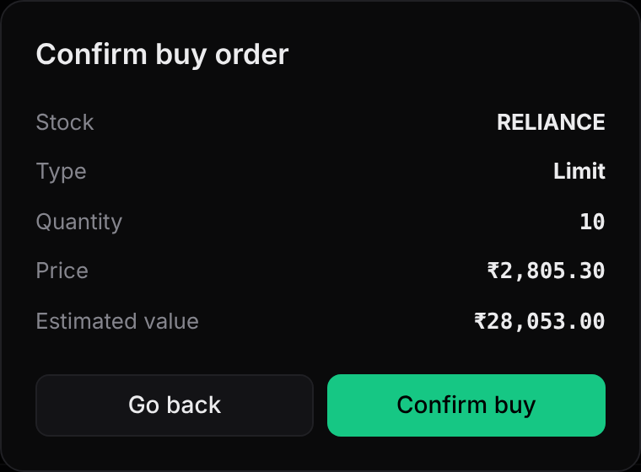
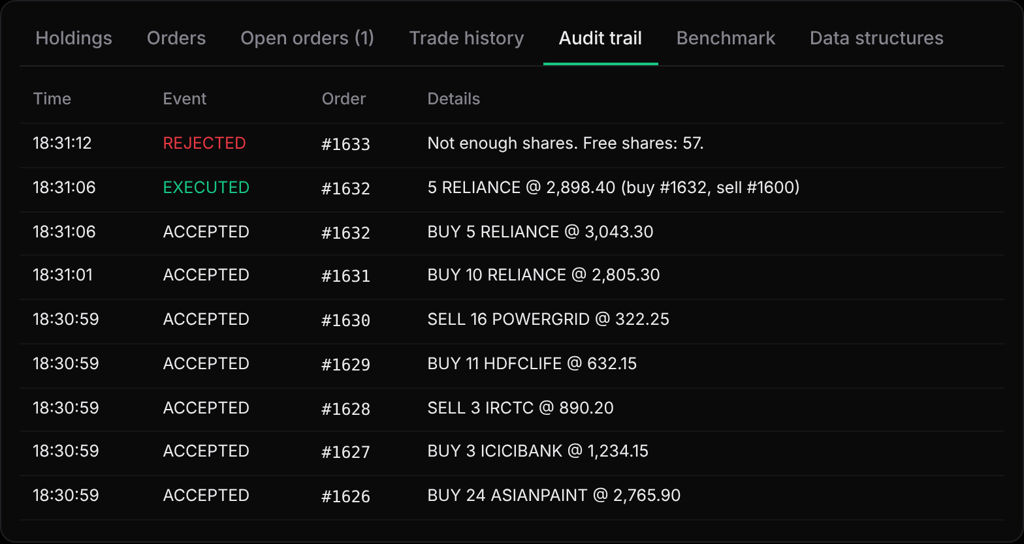
Every order is confirmed, matched and logged
Confirmation dialog: limit buy of 10 RELIANCE
Audit trail: a rejected sell (not enough shares), an executed market buy at ₹2,898.40 inside its ₹3,043.30 cap, and accepted orders.

Slide 12
All 17 engine tests passed
Test | Result
Equal price: earlier order fills first | PASS
Trade at the resting order's price | PASS
Partial fill keeps the rest in the book | PASS
Market order cancels the unfilled rest | PASS
Cancelled order skipped at the heap top | PASS
Buy rejected without enough cash | PASS
Locked cash can't be reused | PASS
Smaller quantity keeps priority | PASS
New price loses priority | PASS
Heap and array engines give same trades | PASS
17/17
tests passed, run on the unchanged engine code in Node.js

Slide 13
The heap pulls ahead as the book grows
2.8×
faster at 1,50,000 orders
Median of 5 runs in Chromium. Both engines produced the same 37,872 trades. A sorted array shifts elements on every insert (O(n)); a heap doesn't (O(log n)).
Notes:
At 10,000 orders the engines tie because the books are small. In Node.js 22 the gap was much larger: the sorted array took 1.8 to 3.1 seconds against about 0.2 seconds for the heap at 1,50,000 orders.

Slide 14


Limitations found and next steps
Limitations
Future scope
Data resets when the page reloads
Cancelled orders stay in heap memory until reached
Bot orders and trade history grow without limit
No self-trade prevention
Needs internet for React and fonts (CDN)
Indexed heap for immediate removal
Stop-loss and good-till-date orders
Save accounts in a database
Multi-user trading over WebSockets
Cap trade history with a ring buffer

Slide 15

A heap is the heart of a fair, fast exchange
Key takeaways
Best price in O(1), orders in O(log n)
Equal prices served first in, first out
17 of 17 engine tests passed
2.8× faster than a sorted array at 1,50,000 orders
Price–time priority in a comparator, O(1) cancels with a hash map, and a bounded audit trail turn textbook data structures into a working trading engine.
Thank you

